Slide 1
MERN Note Keeping App

Slide 2
Objective:
Develop a secure, real-time note-taking app with CRUD operations.
Implement user authentication and responsive design.
Benefits:
Organize notes efficiently.
Accessible across devices.
Secure data with JWT authentication.

Slide 3
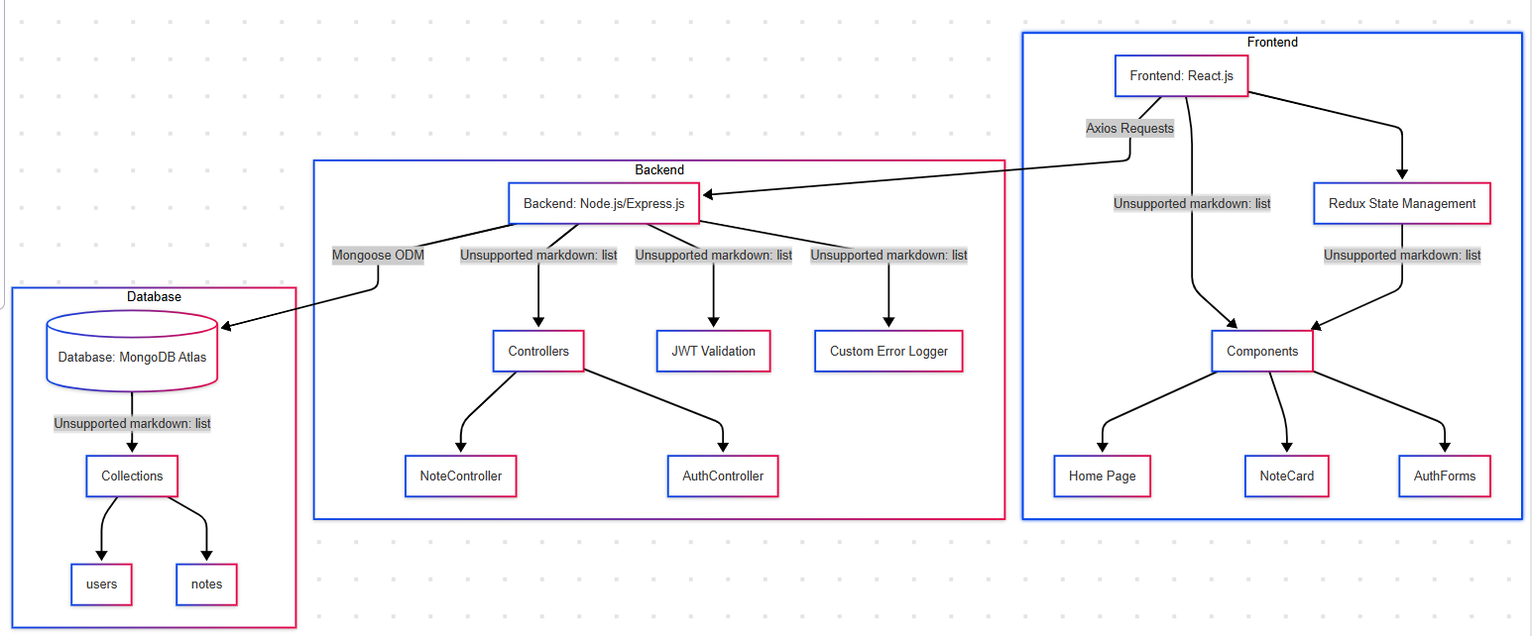
Architecture

Slide 4
Data Flow:
User Authentication - Login/Signup → JWT Token → Protected Routes.
Note Operations: Create/Read/Update/Delete→ MongoDB.
Search: Real-Time Filtering via API.

Slide 5
Key Features:
User Auth: Email/password + JWT.
Smart Organization – Pin important notes, add tags, and search instantly.
Text Notes –User can Create, edit & Delete notes.
Anywhere Access – Responsive design works on mobile and desktop.

Slide 6
Deployment:
Frontend: Hosted on Render.
Backend: Deployed on Render.
Database: MongoDB Atlas (Cloud).

Slide 7
Q & A:
Q1) What’s the tech stack?
MERN (MongoDB, Express, React, Node.js).
Q 2) How is data secured?
JWT tokens, password hashing (bcrypt).
Q 3) How are notes stored?
MongoDB documents with user-specific collections.
Q 4) Can I use it offline?
Future update (Service Workers + IndexedDB).

Slide 8
Next Steps:
Offline mode.
AI-powered note suggestions.

